Slide 1
Predicting Customer Churn for SyriaTel
A Machine Learning Approach to Retaining Customers
By: Stephen Kahuthu
Date: 01 Sep 2024

Slide 2
Introduction
Customer churn is a situation where customers stop doing business with a company or cancel their subscriptions
Why Customer Churn Matters
It leads to significant revenue losses.
Acquiring new customers is more expensive than retaining existing ones.
Objective: Reduce churn to enhance profitability and customer loyalty.

Slide 3
Project Objective
Goal:
Build a predictive model to identify customers who are likely to churn.
Explain how the model will enable SyriaTel to take proactive measures to retain at-risk customers.
Outcome: A model that predicts churn with high accuracy, allowing for targeted retention strategies.

Slide 4
Business Understanding
Churn impacts revenue and customer lifetime value.
Understanding customer behavior is key to improving retention.
E.g.: Customers with frequent service issues may be more likely to churn.

Slide 5
Data Overview
Dataset provided by SyriaTel on url:’https://www.kaggle.com/datasets/becksddf/churn-in-telecoms-dataset’
Dataset includes customer demographics, account details, and usage metrics.
Key Features: Age, contract type, monthly charges, and customer service calls.
Target Variable: Churn (Yes/No)

Slide 6
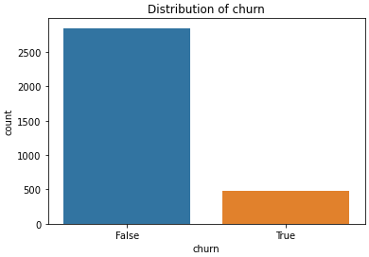
Exploratory Data Analysis
Churn rate in the dataset is around 14.5%.
This bar plot shows the churn distribution

Slide 7
Exploratory Data Analysis Cont’d
Correlation: Features like tenure and service calls are strongly related to churn.
See the correlation matrix in the next slide

Slide 8
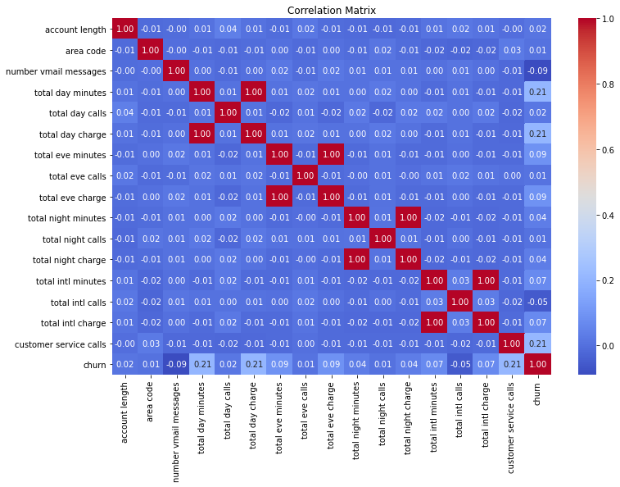
Exploratory Data Analysis Cont’d

Slide 9
Modeling Approach
The modelling approach was done by having three models as below to pick the best for deployment.
Baseline Model: Dummy classifier to benchmark performance.
Logistic Regression: Chosen for its simplicity and effectiveness.
Decision Tree: Offers interpretability and captures non-linear relationships.

Slide 10
Model Evaluation
Metrics: Accuracy, precision, recall, F1 score, and ROC-AUC.
Comparison: Logistic regression outperformed other models.
ROC-AUC: Indicates logistic regression has the best ability to distinguish churners.

Slide 11
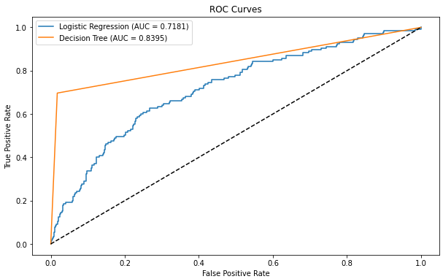
ROC Curve Comparison
ROC curve compares true positive rate vs. false positive rate.
This is the roc-auc curve for the three models

Slide 12
Decision tree: Highest AUC (Area Under the Curve), indicating strong performance.
logistic regression performs well but slightly less effective than Decision tree.

Slide 13
Conclusion
Best Model: Decision tree provides the most balanced and accurate predictions.
Business Impact: Helps SyriaTel identify and retain high-risk customers.
Key Insight: Data-driven decisions can significantly reduce churn.

Slide 14
Recommendations
Target High-Risk Customers: Use model predictions for focused retention efforts.
Personalized Offers: Provide incentives to prevent churn.
Monitor and Improve: Continuously refine the model for better accuracy.

Slide 15
THE END
Thank you for this opportunity to help you reduce the company churn rate through data analysis insights.
Q & A

